Slide 1

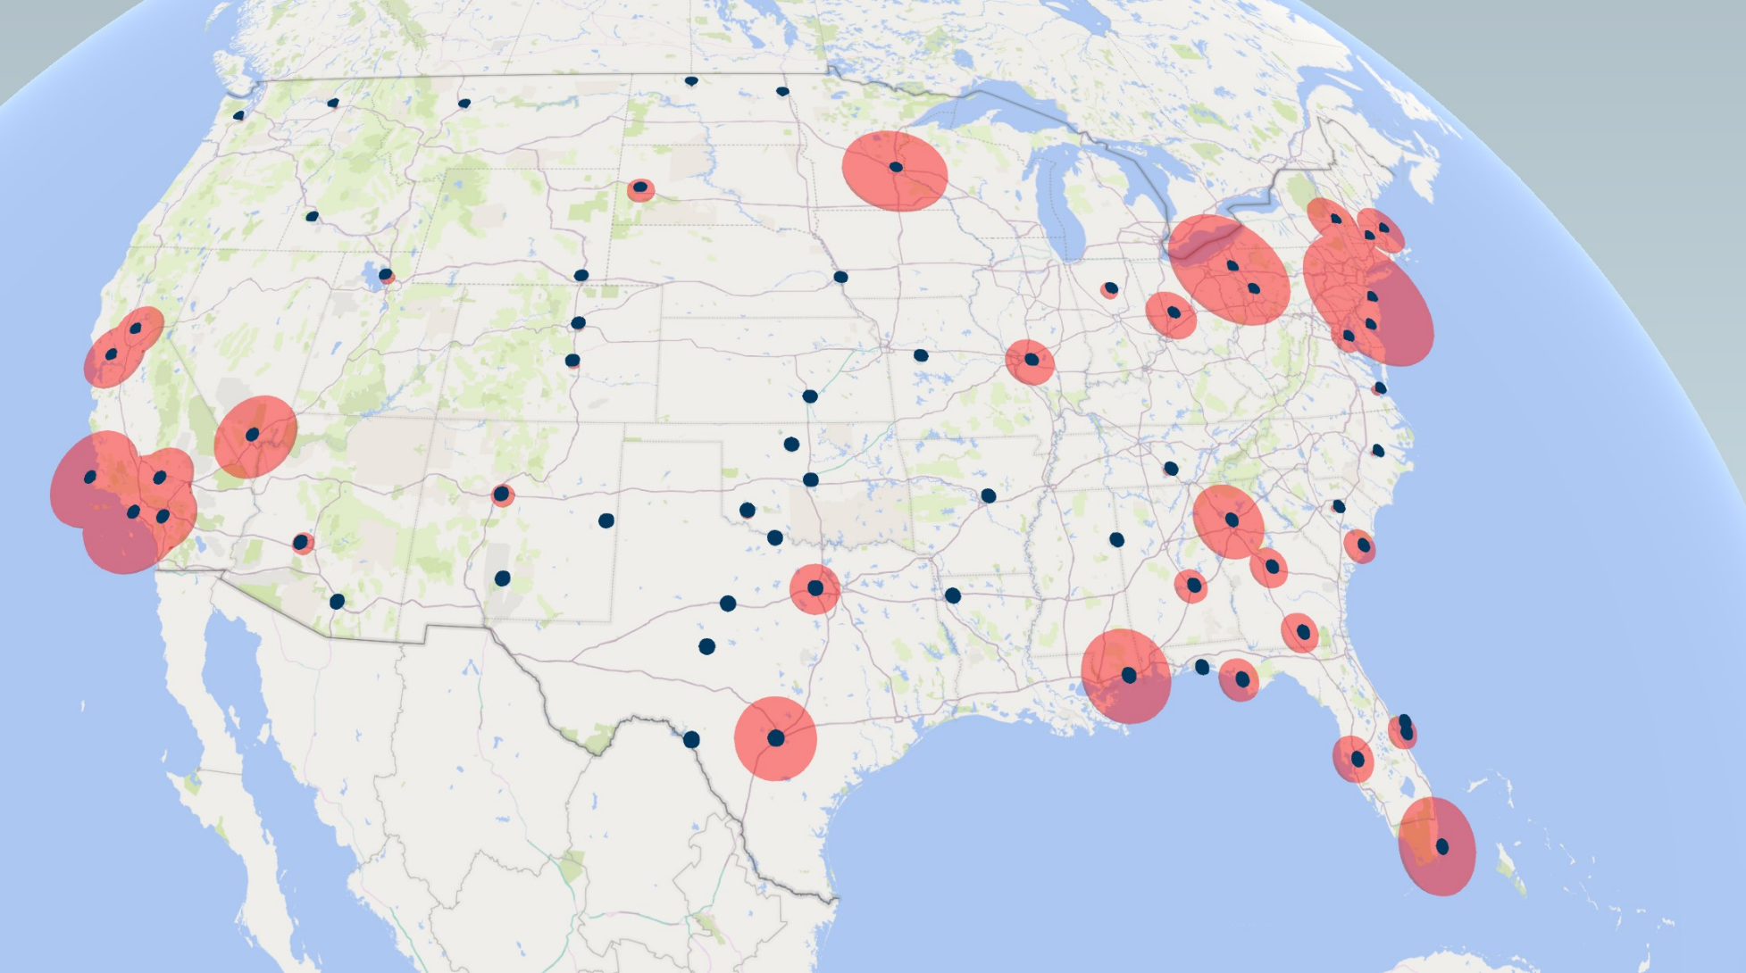
CAO: 13 May 2020
“RIVAL” Installation Risk Vulnerability Assessment Library
Lt Col Jeff “Criv” Crivellaro

Slide 2
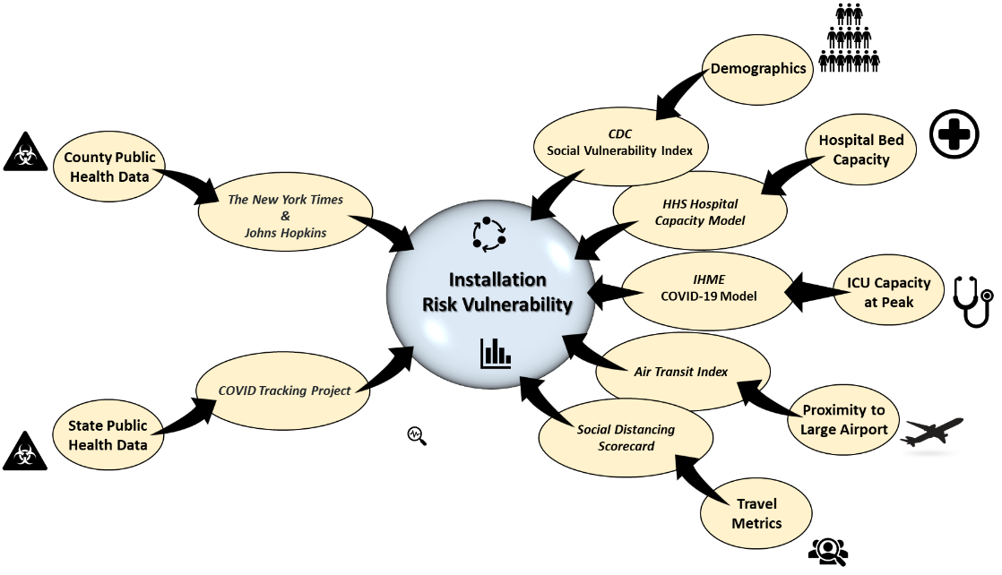
Installation Risk Vulnerability Assessment (RIVAL)
Purpose: RIVAL presents a snapshot of installation risk vulnerability based on current conditions and disease vectors in order to provide decision-makers with focused and relevant data.
Human Factors
Capacity
Demographics
Exposure
Compliance
Disease Factors
Transmission
Detection
Severity
Percent Change in Average Distance Traveled
A: >70% decrease
B: 55-70% decrease
C: 40-55% decrease
D: 25-40% decrease
F: <25% decrease or increase
Percent Change in Non-essential Visitation
A: >70% decrease
B: 65-70% decrease
C: 60-65% decrease
D: 55-60% decrease
F: <55% decrease or increase
Installation Scorecard
Score:
Cases/100K:
7-Day Case Rate:
7-Day Death Rate:
Test/Day Grade:
Prevention Grade:
Medical Capacity Grade:
Risk Vulnerability Assessment
All Counties w/in 60 Miles
Compounded over last 7 days
Compounded over last 7 days
A/B=exceeds, C=meets, D/F=deficit
Social Distancing Compliance
Bed/ICU + IHME capacity

Slide 3








Defining Risk Vulnerability
What factors make an installation vulnerable to the COVID-19 outbreak?
Disease Growth
Transmission Rate
Severity
Medical Capacity
Beds/ICU
Projections
Installation
Risk Vulnerability
Case Density
State vs. Local Area
Case & Death Rates State vs. Local Area
Local Area Prevention
Social Distancing
Social Vulnerability
Bed/ICU Capacity
Local Area Assessment
Projected Capacity
Local Area Modeling
Confidence
State Testing/100K
Vulnerable Groups
% Local Population > 65
Case Trajectory?
Return to Work
Phase 1
White House
Gating Criteria
Medical Capacity?
Decreasing
Robust Testing?
Cases /Day < 10% of Total Tests/Day
Treat All

Slide 4
Shifting HPCON Status
When to lower (return to work) and raise (restrict) HPCON levels:
Case Trajectory?
Return to Work
Phase 1
White House
Gating Criteria
Medical Capacity?
Decreasing
Robust Testing?
Cases /Day < 10% of Total Tests/Day
Treat All
1. (Local Area) Cases/100K
2. (Local Area) 7-Day Case & Death Rates
3. (State) Test Rates
Testing = Confidence in case/death rates
WHO goal = New cases per day is < 10% of Tests per day
Grades: A = Exceeds 3% Epidemiological Standard
B = 3-7 %
C = 7-12%
D = 12-16%
F = > 16% (US Average is 20%)
4. (Local Area) Social Distancing Compliance
5. (Local Area) Medical Capacity Assessment and Projections
6. (State) 14-Day Case Trajectory

Slide 5
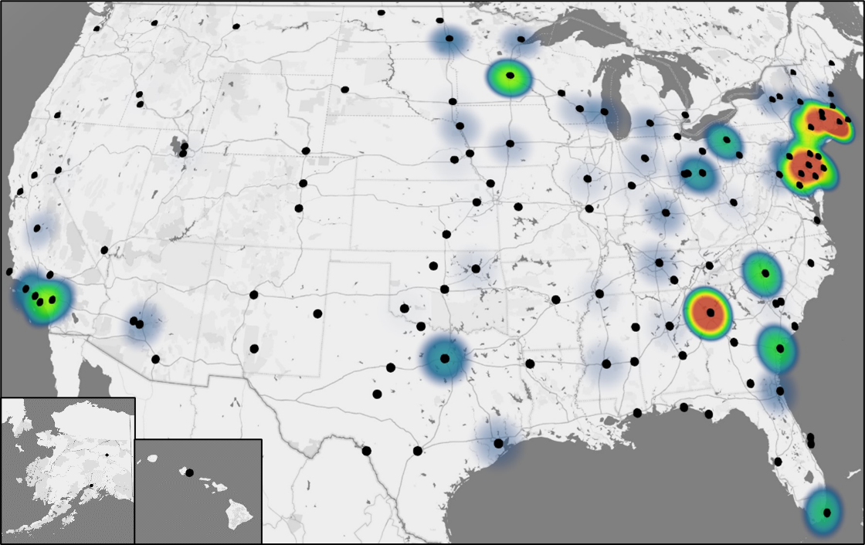
USAF Installations (A-D)
CAO: 13 May 2020
Increase in Case and Death rates over last 7 days

Slide 6
USAF Installations (E-L)
CAO: 13 May 2020

Slide 7
USAF Installations (M-W)
CAO: 13 May 2020

Slide 8
USAF Core Missions (1 of 2)
CAO: 13 May 2020

Slide 9
USAF Core Missions (2 of 2)
CAO: 13 May 2020

Slide 10
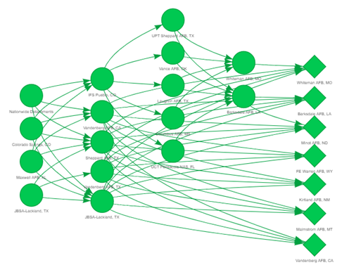
Human Supply Chain Pipeline
CAO: 13 May 2020
Nuclear Surety Training Pipeline
Accession
Tech 1
Tech 2
Tech 3
Operational

Slide 11
Resetting the Force During a Pandemic
Purpose: Our antiquated systems, military cultural norms, over-reliance on in-person activities, and expected budgetary constraints necessitates a reset of the force to meet the challenges in a COVID-19 global environment and beyond
Problem Statement: The DAF must adapt policies, practices, and guidance in order to reset manpower, materiel, and operations that balances mission execution with force health protection in both the current and future pandemic environments
Phase 1: Normalizing operations (Jun – Dec 2020)
Near-term LOE: Address acute manpower, materiel, and operations requirements (Must do…)
Objectives
Develop a CONOP that:
Addresses antiquated IT systems and an over-reliance on in-person activities
Clearly defines transition criteria between HPCONs
Develop a timeline and testbed to exercise the CONOP in preparation for phase 2 transition
Phase 2: Reshaping the Force (Jan-Jun 2021)
Mid-term LOE: Expanded manpower, materiel, and operations capacity (Should do…)
Objectives:
Expand the CONOP to include:
Alternate operations (training, PCS Cycling vs. Homesteading, PME)
Military cultural norms (Esprit-de-corps, grooming, fitness, and discipline standards)
Dilemma of health stigmas (who goes to work vs. stays home vs. who seeks medical care)
Mitigating an out-group/in-group perception (telework vs. in-person)
Develop a timeline execute the expanded CONOP for the long-term
Desired State: An AF capable of fighting through pandemics to implement the NDS

